Slide 1

Tokenization Daniele Marazzina

Slide 2
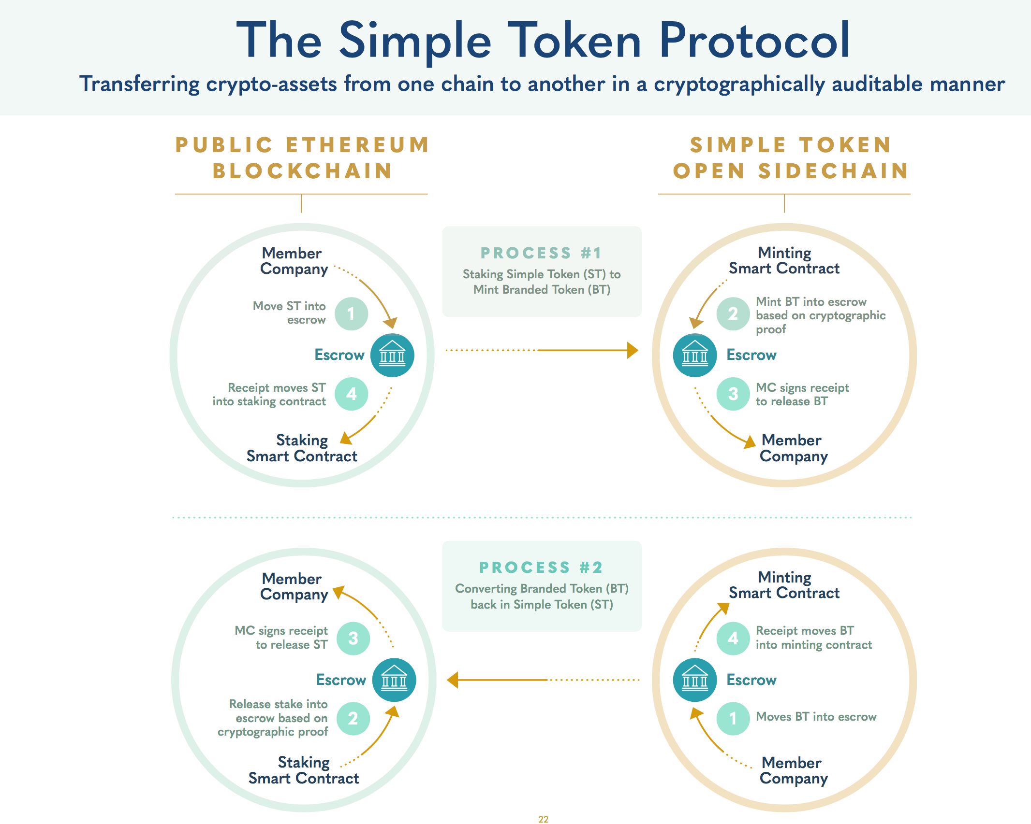
Opportunity - Token Economy
Tokenization is a real opportunity that is emerging as a technological trend in the Defi environment
In fact, the first generation of blockchain did not allow to structure complex scenarios in terms of business
Today the new generation of technologies allows to refine the construction of more advanced service models

Slide 3
DEFI
DLT TECHNOLOGIES
TOKENIZATION IS THE «OPPORTUNITY»
DLT
The chronological register of transaction data
MARKET
NON GOVERNED
Everybody is able to access DLT
GOVERNED
Nodes need a permission to access the network
Bitcoin
Hyperledger
Stellar
Ethereum
(OVERALL MATURITY
Corda R3
ALGORAND
ETHEREUM
(also
with sidechains)
CORDA R3
QUORUM
Quorum
The new protocol for financial us cases
For financial use cases
Almost very kind of context
The original “smart contracts” platforms
Tobalaba
Algorand
RESEARCH
TOKENIZATION SUPPORTED

Slide 4





BLOCKCHAIN: ASSESSMENT for DEFI
Self organizing
governance
Network is scaling
with same
performance
Posibility to Create token
Pragmatic
interoperability
Data, ledger and
participants are encrypted
Agreement by all
participants
Acceptable scaling
and performance
Token
standardization
Semantic
interoperability
Compliance
regulation
Agreement by certain nodes
Medium number
of nodes for scaling
Token exchange
Common data
format
Data is encrypted
Centralized governance
Limited amount of nodes for normal performance
Only one Native token
Communication
Protocol
Unauthorized access
of participants
One governor for the whole network
System failure
There is no token
Stand- Alone
Append-only Data structure
GOVERNANCE
SCALABILITY AND
PERFORMANCE
TOKEN
INTEROPERABILITY
PRIVACY
BLOCKCHAIN ASSESSMENT MODEL-PROJECT DLI- © All Rights RESERVED CEFRIEL 2019

Slide 5
Blockchain for Defi
Ethereum + decentralization :
Tezos : PoS
Algorand :
Cardano :
Quorum
Corda R3
EoS :
Stellar : Permissioned validators
Ripple - decentralization :
More than 80% of Defi solution is on Ethereum
Algorand is a promising technology (but young)

Slide 6
Insight 1: Ethereum
Ethereum’s Tokens
Any fungible commodity can be represented by a token derived from Ethereum ‘s ERC-20 standard
Non fungible tokens can be derived from ERC-721 ( like the ones adopted in side-chains)
This recent standard has made possible to represent goods like pieces of art, personalized access rights, properties.
ERC 20 ( Fungible | ERC721 ( non fungible)
Not applicable | Associated with a unique ID
Not Unique | Unique
Not tied | Tied to the identity of a person

Slide 7
Ethereum → ERC20 vs. ERC721
ERC 20
function name()
function decimals()
function totalSupply()
function balanceOf( owner)
function transferFrom( from, to)
function approve( spender, value)
It is possible to verify your (_owner) account and make transfers.
INTERESTING: It is possible to authorize a third party to make payments from your account within a certain limit. It could be a smart contract (open banking ...)
It is NOT possible to associate information with a specific token
ERC 721
…
function ownerOf( tokenId)
function transferFrom( from, to, tokenId)
It is possible to associate an owner with a single token, let's think of a voucher, a paycheck, or a work of art
It is possible to transfer a specific token

Slide 8

Insight 2: Algorand
Algorand
Algorand is a latest generation blockchain developed by a team led by Silvio Micali (MIT-Boston and Turing award), in production since 2019, whose innovative features are:
security, scalability, fast transactions (seconds), decentralization, possibility to define and integrate subsystems, e.g. local administrations, highly tested tools.
Algorand's goal is the borderless economy, with a view to developing decentralized and sustainable finance services, to enable cooperative and collaborative scenarios.
The Algorand platform lends itself to applications such as local currencies or functional tokens aimed at distributing financial resources in various forms, with the already known advantages of decentralization (more direct and efficient mechanisms, more immediate reconciliations, greater transparency).

Slide 9
Tokens
“Cryptographic tokens represent programmable assets or access rights, managed by a smart contract and an underlying distributed ledger. They are typically accessible only by the person who has the private key for that address and can only be signed using this private key. “
Fonte: Tokenomics, Sherming V., June 2020

Slide 10
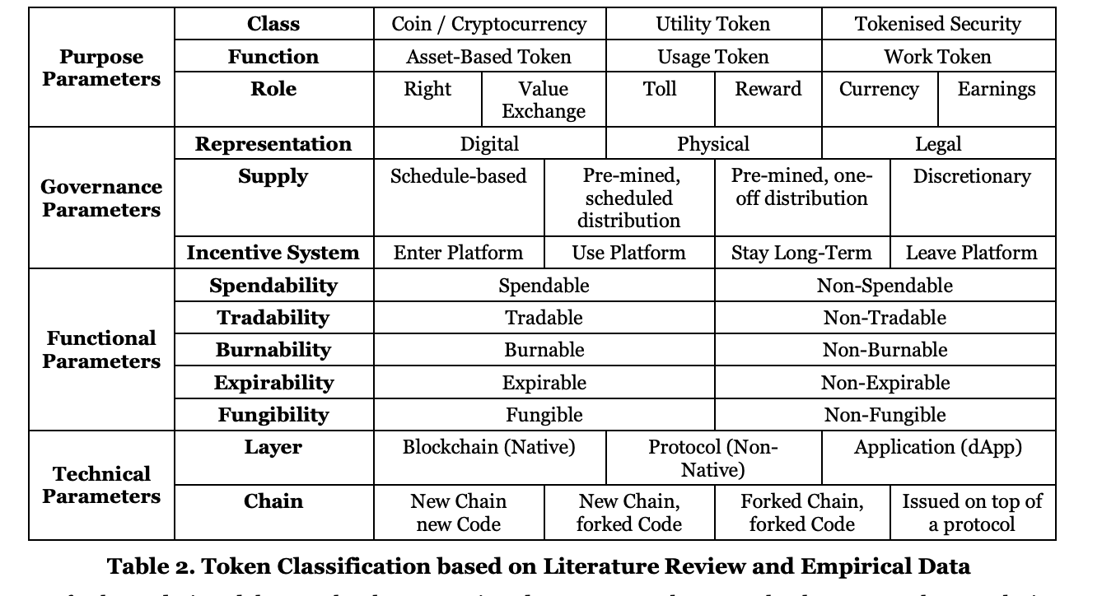
Classificazione Token Defi
Source: https://www.zora.uzh.ch/id/eprint/157908/

Slide 11
Classification – Purpose parameters
PARAMETRI
Class: digital money (Cryptocurrencies), digital shares with entitlement to profit-sharing or dividends (Tokenised Security), remaining crypto-assets (Utility Tokens).
Function: represents an asset (Asset-Based), confers to its holder an access permission (Usage Token) or rewards a certain behaviour (Work Token)
Role: guarantees a right to its holder (Right), represents a unit of value exchange in an internal system (Value Exchange), a fee for pay-per-use or access purposes to a platform (Toll), embodies a tool to reward user behaviour (Reward), constitutes a de facto payment method (Currency) or embodies the
right to confer profit-sharing to the token holder (Earnings).

Slide 12
Classification - Governance parameters
Representation: tokens may represent pure digital assets (Digital), be bound to physical objects (Physical), or represent legal rights (Legal).
Supply: a token supply behaves according to specific rules or not
Incentive System: tokens incentives to Enter, Use or Stay Long-Term in a Platform, or use the token, leaving the platform.

Slide 13
Classification - Functional parameters
Spendability: tokens which can be spent in a platform are considered Spendable, whereas the
remaining are Non-Spendable.
Tradability: in most cases tokens’ ownership may change hands (Tradable), though there are
cases where this is not possible (Non-Tradable)
Burnability: tokens are burned to express the extinction of a right/access, or to create scarcity
Expirability: tokens which expire at a certain time
Fungibility: a fungible asset is interchangeable with another asset of the same category.

Slide 14
Example: Restaurant Voucher

Slide 15
Technical Solution

